Slide 1


Health Evaluation Project
"AI-Powered Health: Personalized Care at Your Fingertips."

Slide 2
GROUP MEMBERS
Sajida Abdul Basit | 2020-MO-715
Azka Yasir | 2020-MO-706
Shumail Zahra | 2020-MO-710
Insha Arif | 2020-MO-714

Slide 3

Introduction To Health Evauation!
What is this project about?

Slide 4
Introduction
This innovative solution integrates a user-friendly chat-bot and a sophisticated prediction model to deliver personalized health insights. Our system provides real-time feedback and tailored recommendations to help users achieve their health goals. The chat-bot acts as a virtual AI Doctor, guiding users through their health journey and answering health-related questions with instant, personalized responses. Utilizing state-of-the-art machine learning algorithms, the prediction model forecasts potential health, early detection and suggests proactive measures, and enabling prevention through AI Doctor.

Slide 5

Objectives
- Early Detection of Heart Disease. - Personalized Healthcare Assistance. - User-Friendly Interface.

Slide 6
Early Detection of Heart Disease.
In the Health Evaluation Project, early detection of heart disease is achieved through a machine learning model trained using an SVM (Support Vector Machine) algorithm. The model analyzes user-provided health parameters.
The SVM model predicts whether an individual is at risk of developing heart disease or not. This approach allows users to receive accurate, data-driven insights into their heart health.
The goal is to enable users to take preventive measures by identifying potential risks early.

Slide 7
Personalized Healthcare Assistance.
For healthcare-related queries, the Botpress AI Doctor uses its specialized training to offer tailored advice and actionable recommendations, the chatbot seamlessly integrates ChatGPT as a backup to ensure users always receive comprehensive and relevant support.
This hybrid AI system ensures an efficient, reliable, and user friendly experience for personalized health guidance.
This dual-AI setup combines domain-specific expertise with general AI capabilities, ensuring that users receive both specialized medical insights and broader conversational support, making the chatbot a reliable virtual healthcare assistant.

Slide 8

User Friendly Interface.
Responsive Design.
Clear Navigation.
Interactive Forms.
Aesthetic Appeal.
Chatbot Integration.
Error-Free Input Handling.

Slide 9
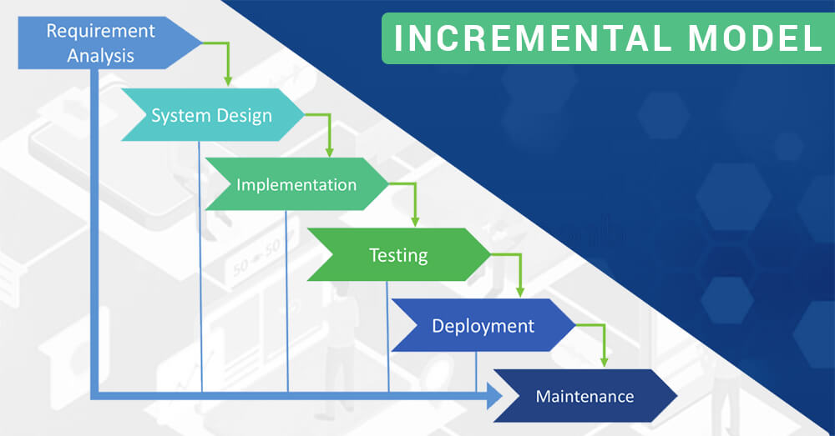
System Architecture
Incremental Model:
In this model, the application is built in small chunks and delivered to the client. With the help of this model client's feedback is received earlier and client receives the system in working state earlier too.
Early Feedback.
Risk Management.
Resource Allocation.
Flexibility and Adaptability.
Incremental Improvements.

Slide 10

Project Framework and Design
Frontend (User Interface).
Backend (Application Logic).
Database (SQLite).
Machine Learning Model (Prediction Model).
Chatbot (AI Doctor).
URLs and Views.
Security and Authentication.

Slide 11
Frontend (User Interface).
Frontend of this project is created with the help of various languages like HTML, CSS, JavaScript, and Bootstrap using Django framework.
Login Page.
Registration Page.
Home Page.
Prediction Model Page.
AI Doctor Page.
Our Team Page.

Slide 12
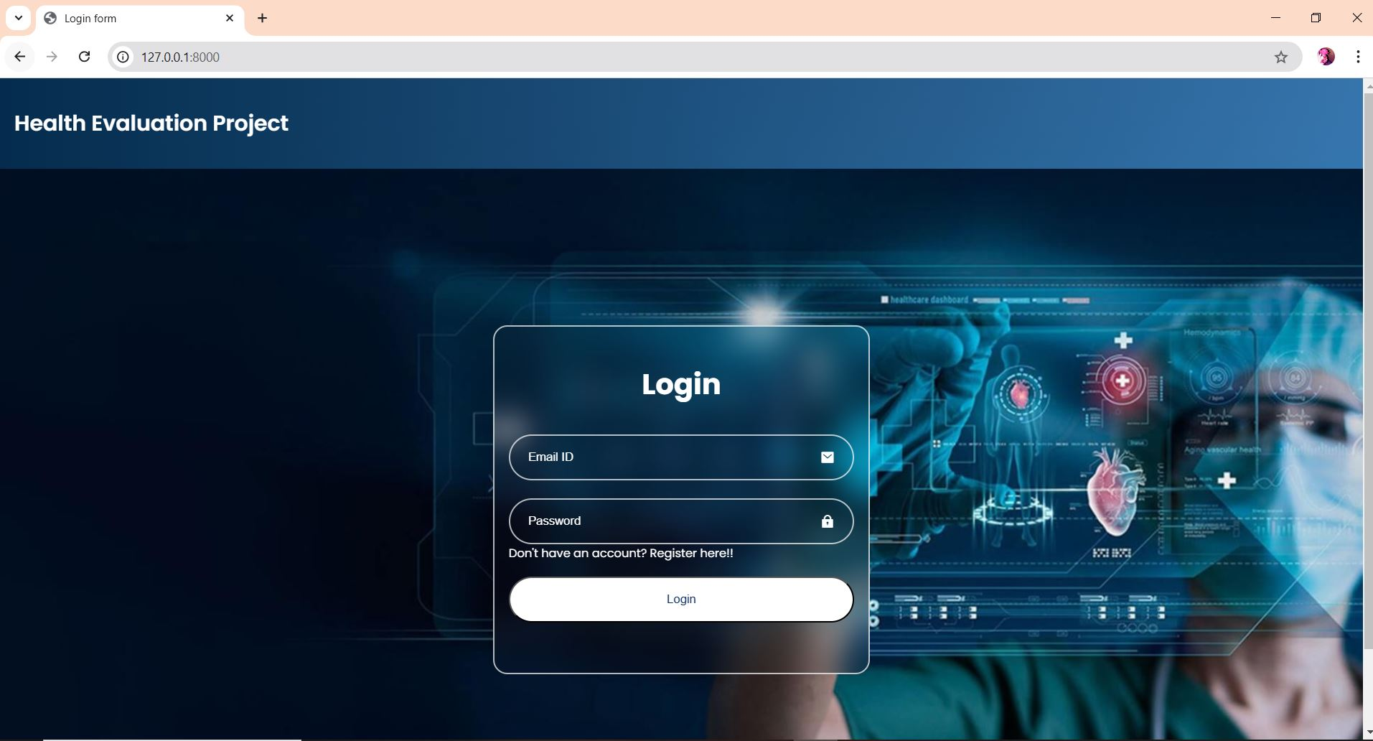
Login Page:
Secure Access Only!
To ensure the best experience and maintain the security of our platform, access is restricted to registered users.
🔒 Login Required You must log in to your account to proceed and access the features of our website.
Don’t have an account yet?
Register Now to create one and unlock the full experience!
If you encounter any issues, please contact our support team.

Slide 13
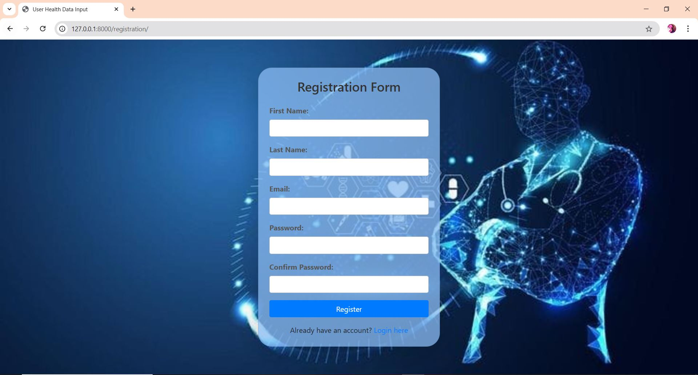
Registration Page :
Register Yourself before logging in!
Register Now to a Login id and have your own identity.

Slide 14
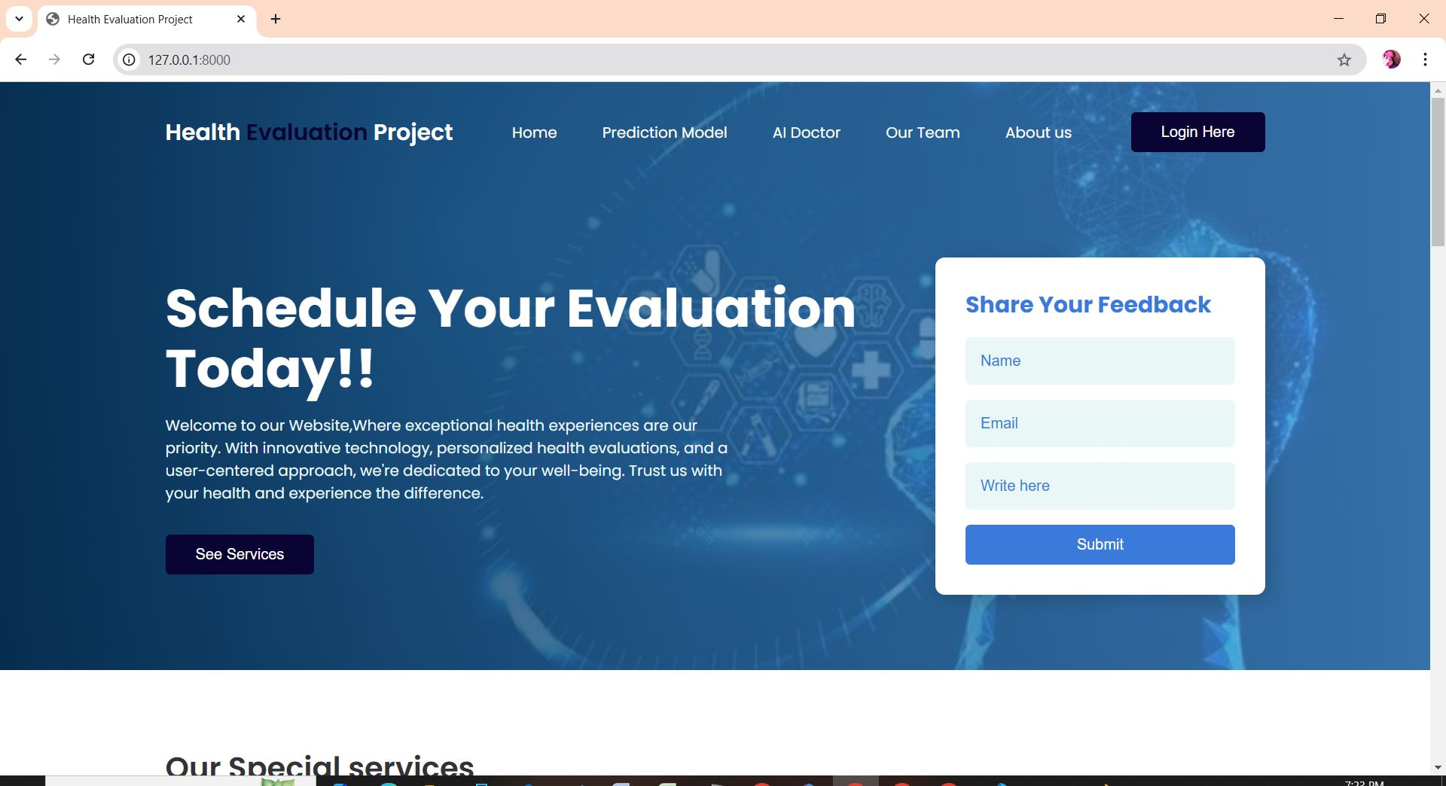
Home Page :
Welcome to Health Evaluation Project Homepage!
The base root of Home, Prediction Model, AI Doctor, Our Team, About Us and Feedback.
User can also see our Services and other info about our team.

Slide 15
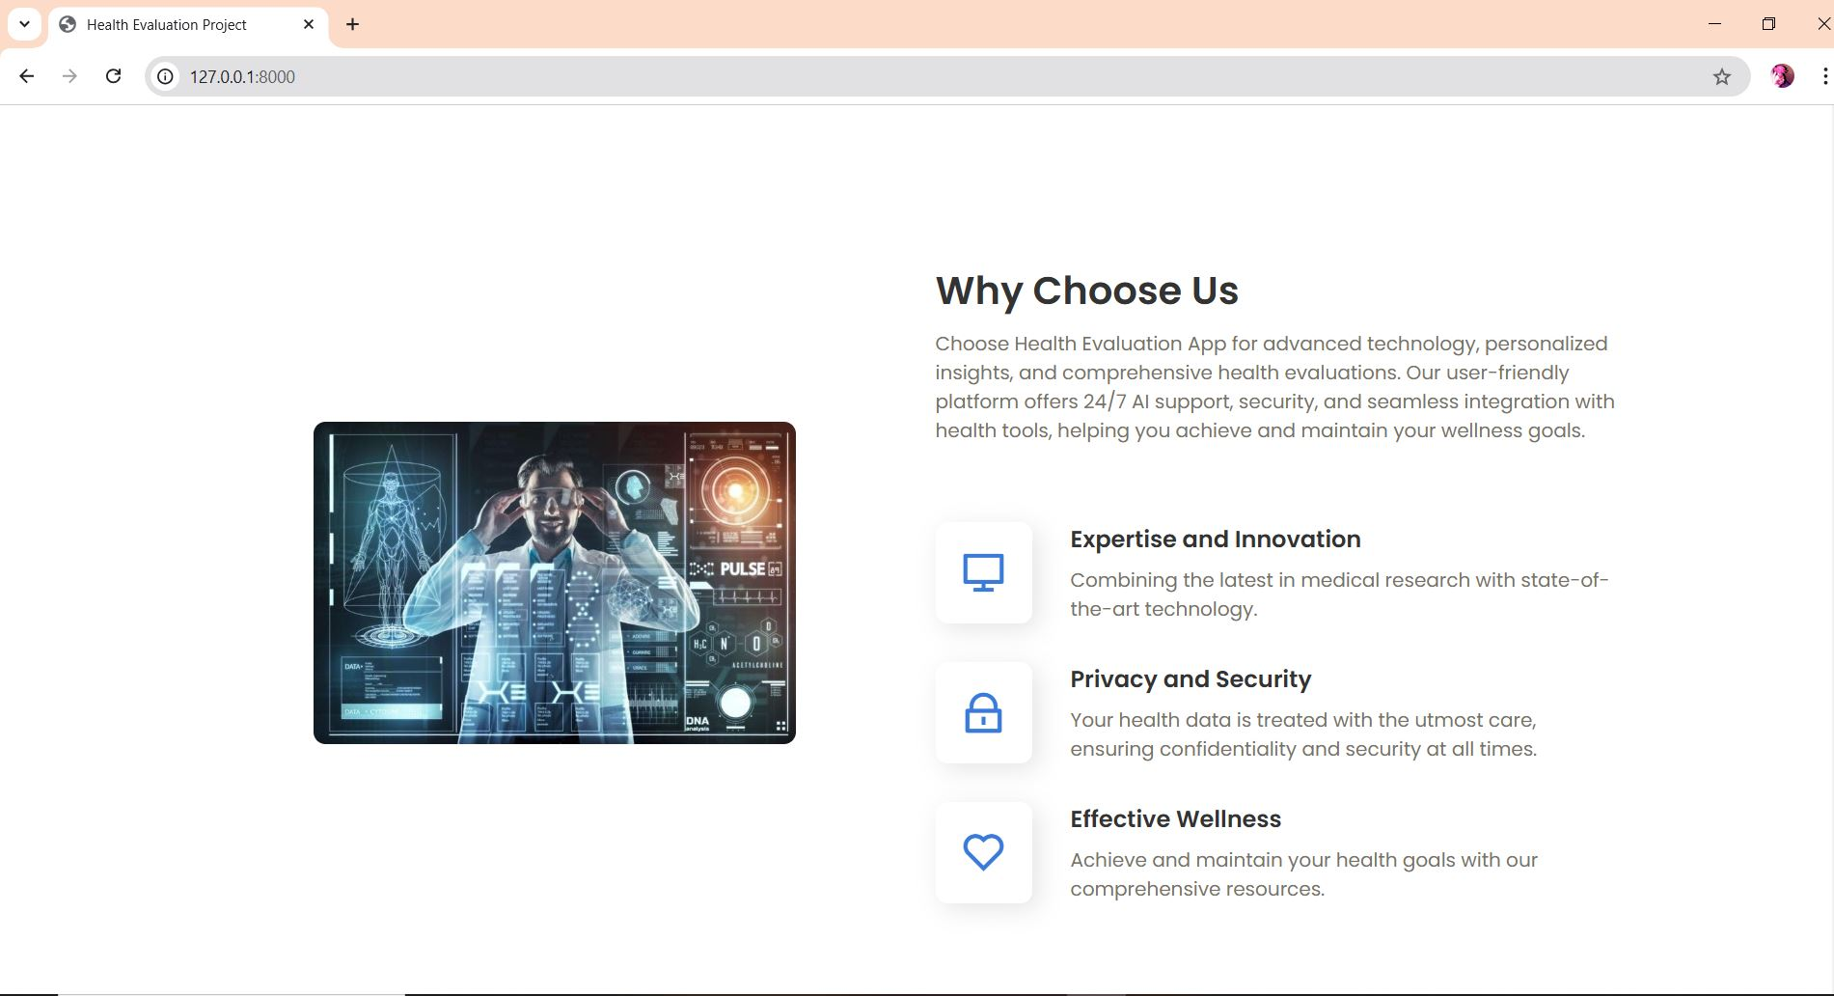
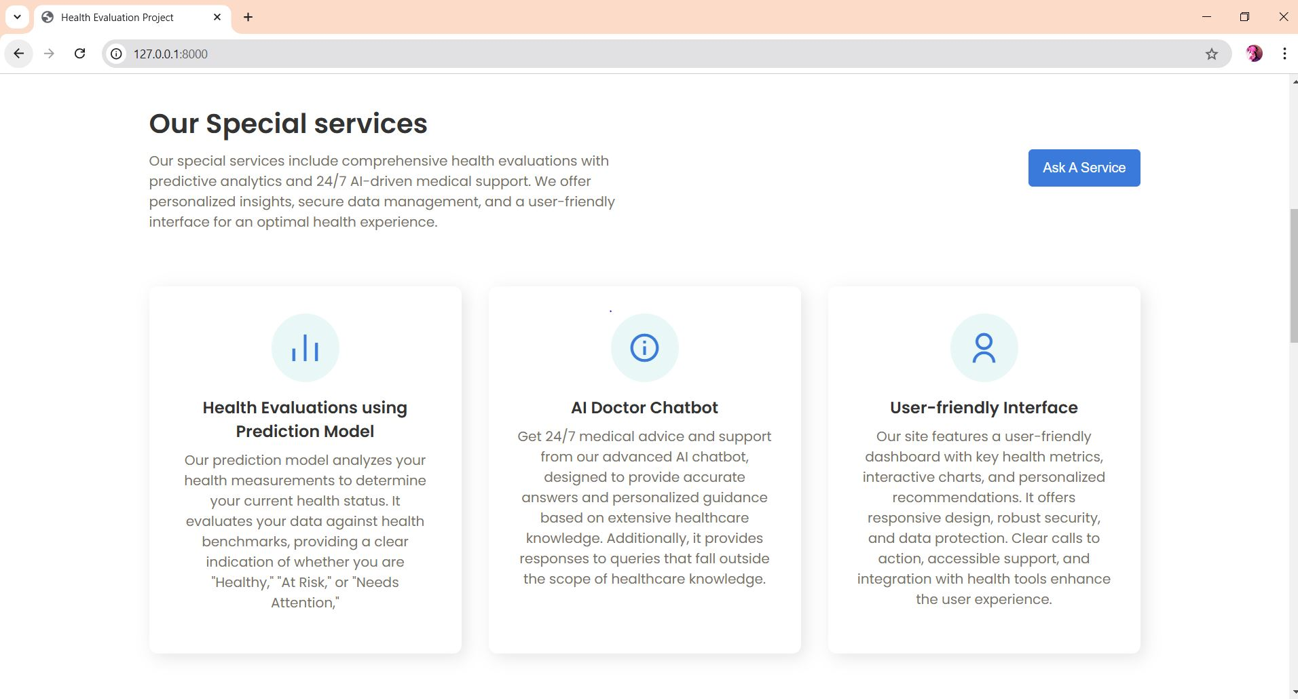
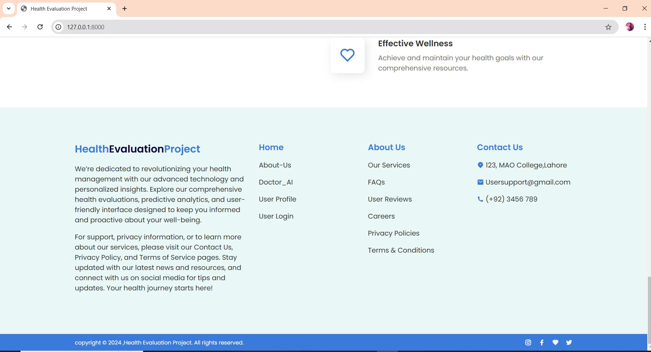
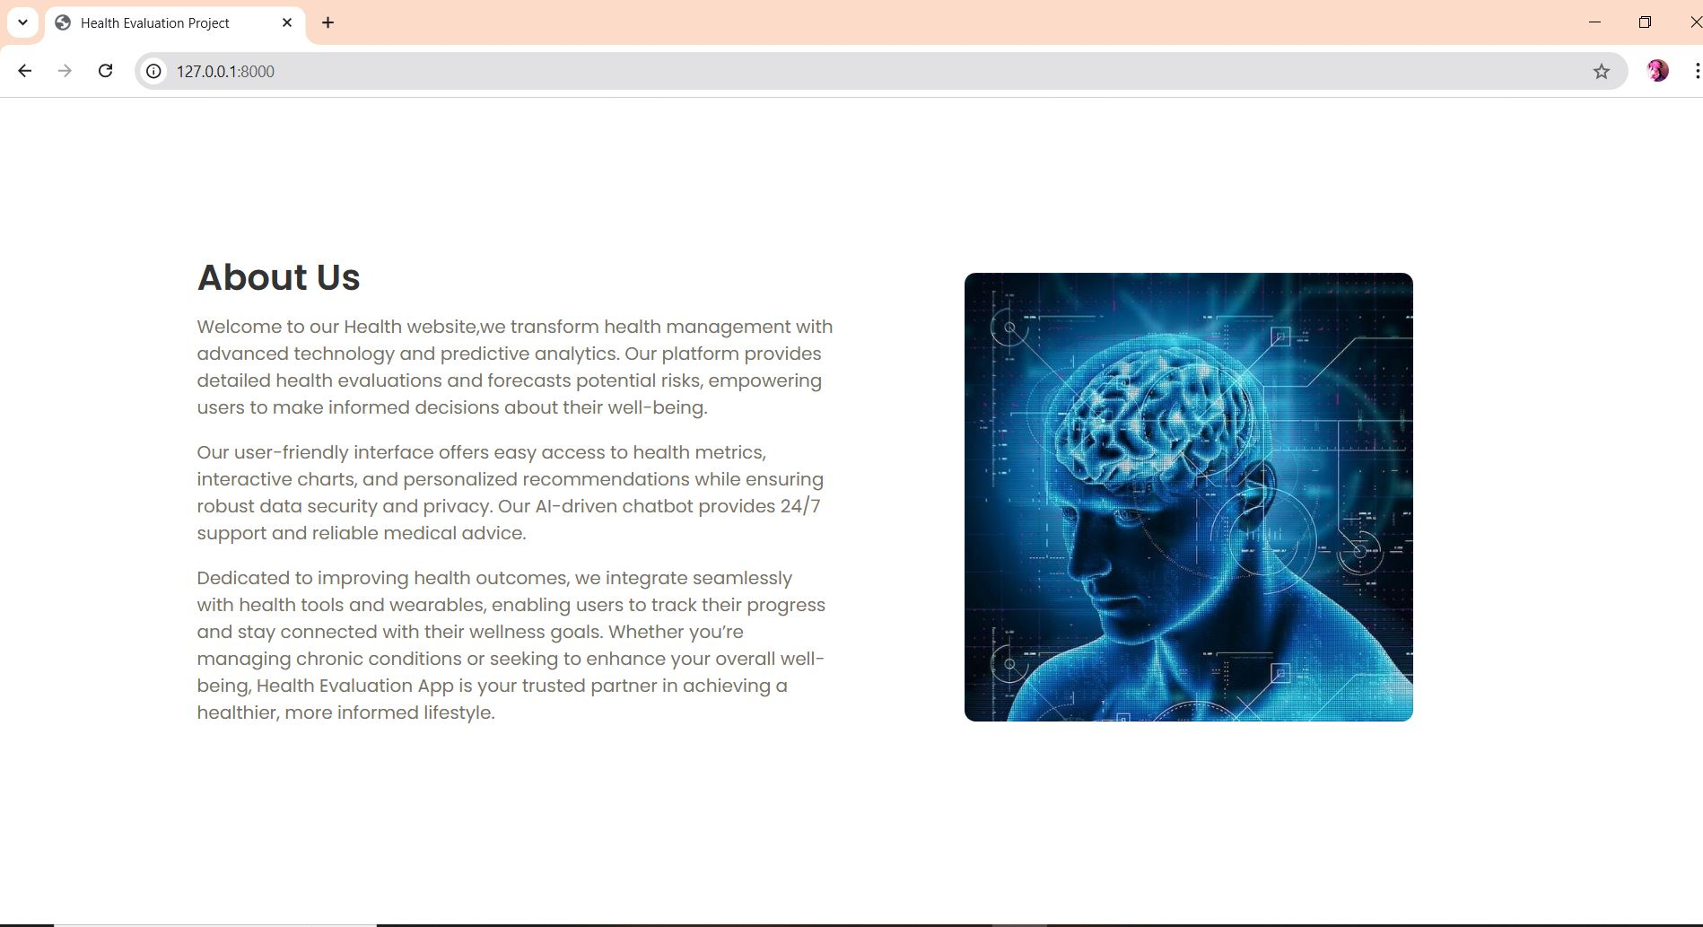
Home Page :

Slide 16
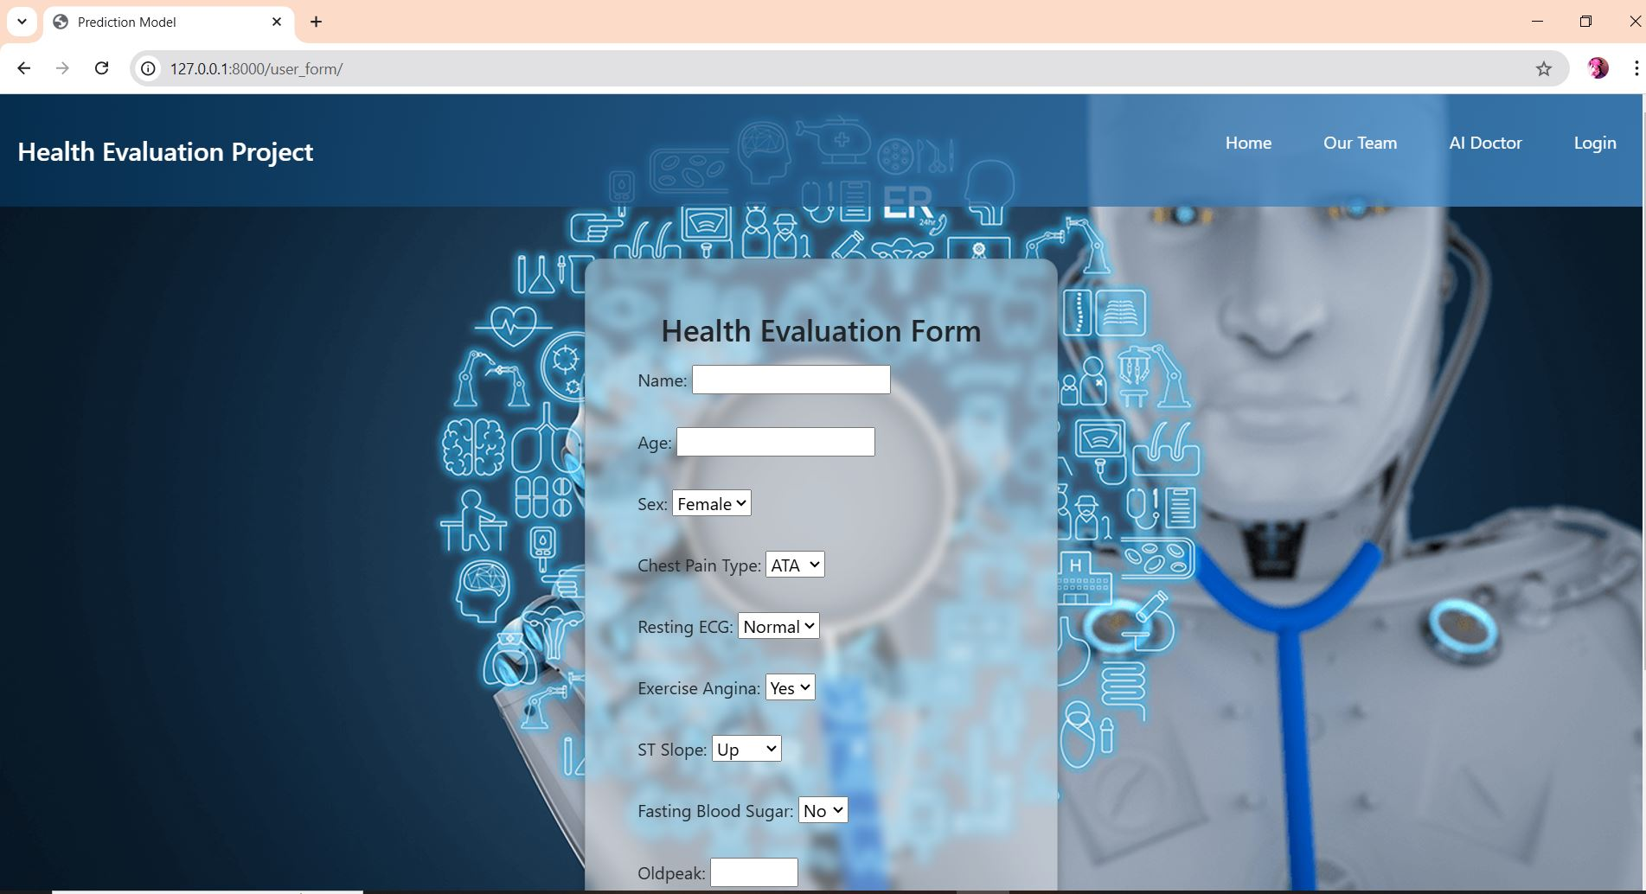
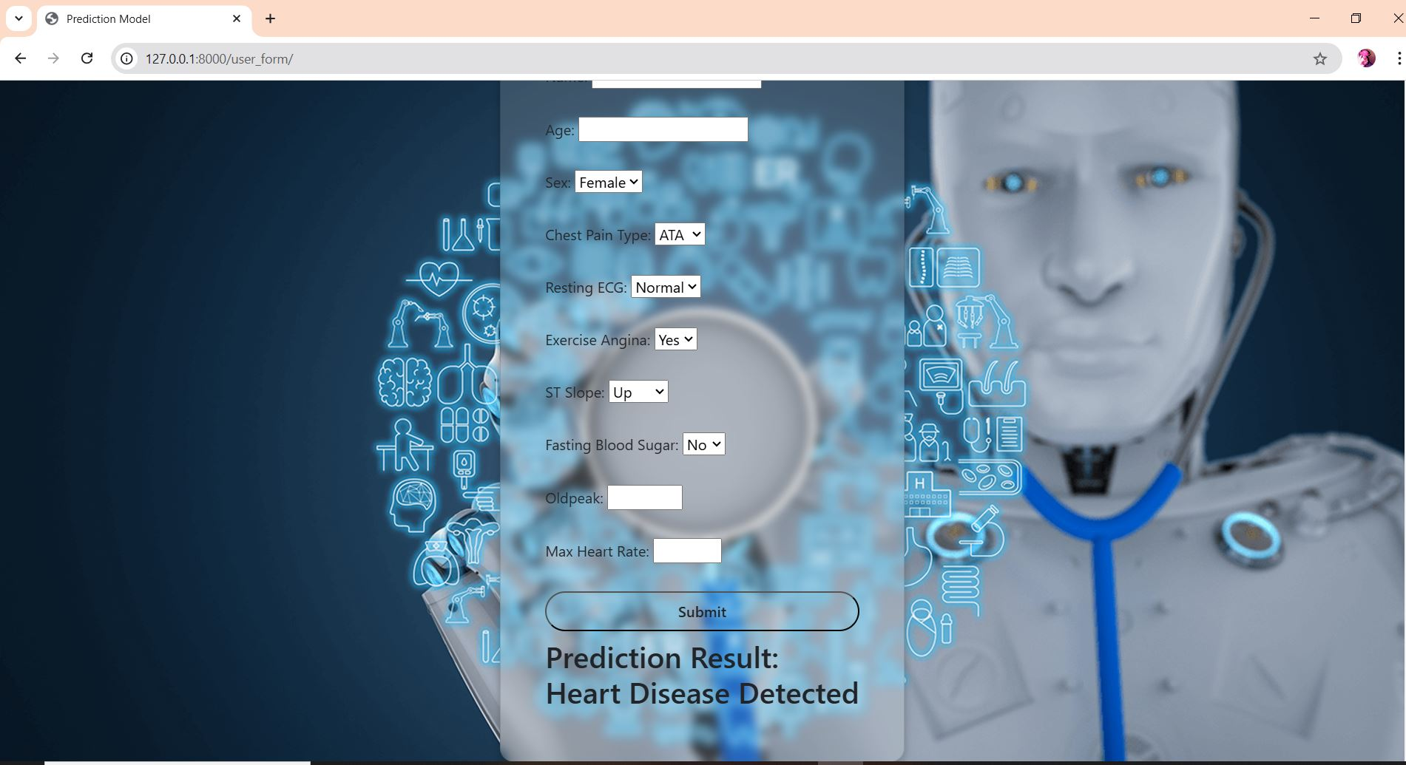
Prediction Model Page :
Prediction Model Page! That evaluates user health and made sure if he had a heart disease or not just by getting various health parameters like:
Age, Sex, Chest Pain Type, Resting ECG, Exercise Angina, ST Slope, Fasting Blood Sugar, Oldpeak, and Max Heart Rate.
and inform user if he really have a heart disease or not.

Slide 17

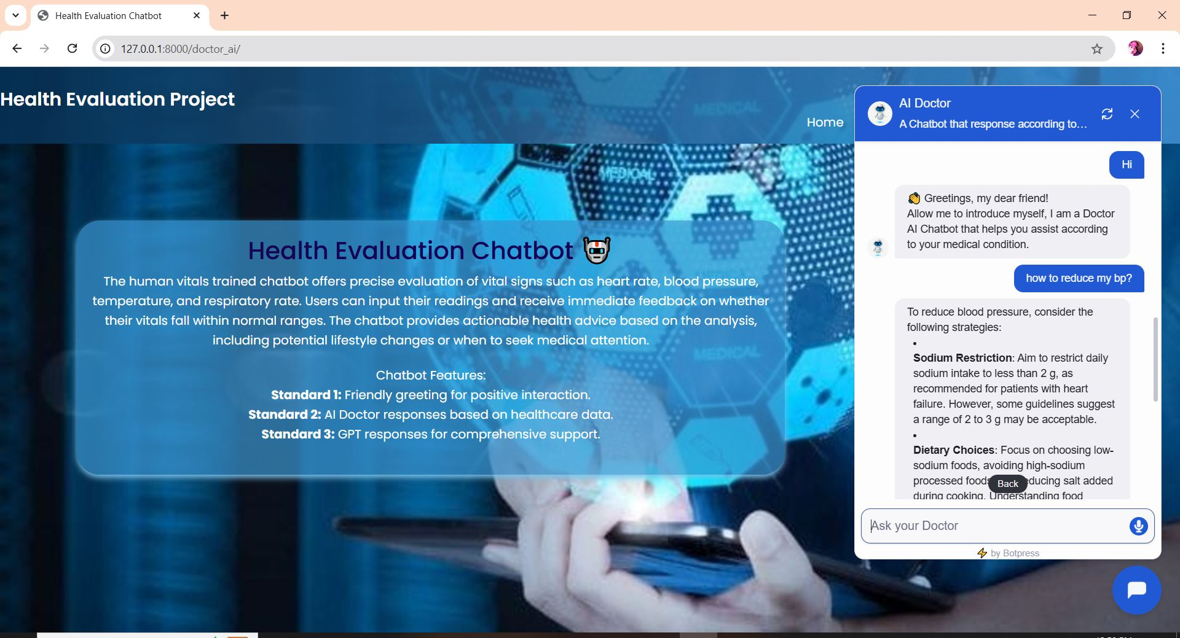
AI Doctor Page :
Say Hello! To our AI Doctor that interact with you throughout your health journey trained on specialized medical knowledge and aspect furthermore covers any health related quires, suggestions, and recommendation.
It’s seamless coverage can answer almost anything do don’t worry if you’re even asking for a pizza recipe our doctor is multi talented. 😉

Slide 18
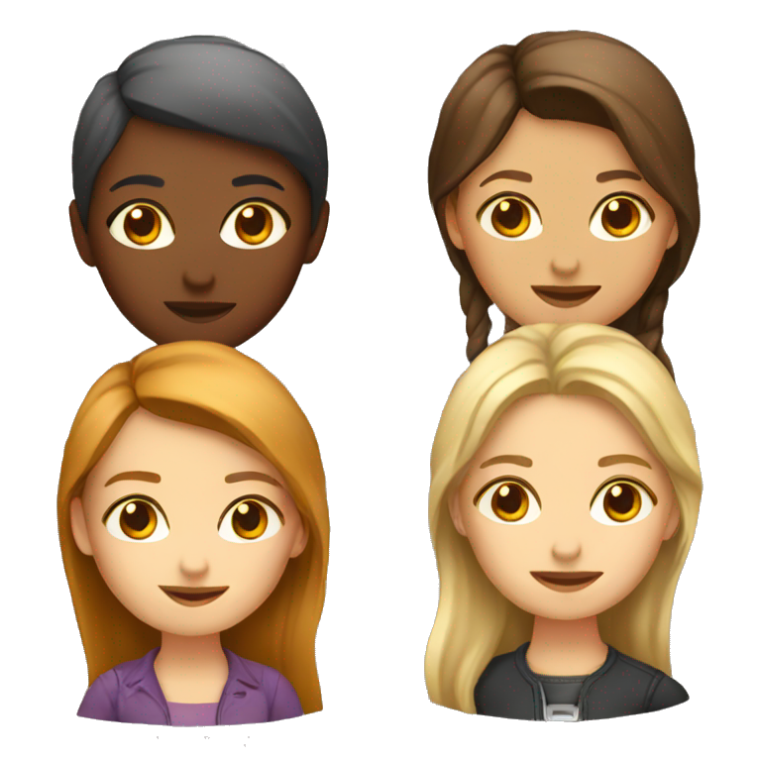
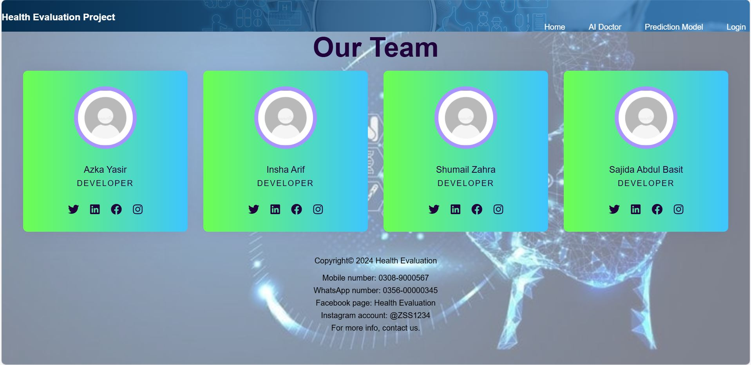
Our Team Page :
Contact our team regarding any problem!
Our team is here a well dedicated team of developers that contribute in the completion of this great project.

Slide 19

Backend (Application Logic).
Backend of this project is created with frame work of Django to integrate.
User Authentication and Authorization.
Database Integration.
Prediction Model Integration.
Validation and Error Handling.
Feedback Submission Logic.
Logging and Monitoring.

Slide 20
Backend.
User Authentication and Authorization
Prediction Model Integration
Database Integration
Secure login and registration system.
Password encryption using libraries like Django's built-in authentication system.
Role-based access control (e.g., admin vs. user).
Management of user data, prediction history, and feedback storage.
Utilization of SQLite (or any other database) for structured data storage.
Integration of the trained heart disease prediction model (SVM) with the backend.
Preprocessing input data using scikit-learn before sending it to the model for predictions.
Validation and Error Handling
Feedback Submission Logic
Logging and Monitoring
Input validation to ensure only correct data is submitted.
Handling errors such as invalid data, unauthorized access, or server downtime gracefully.
Backend functionality to handle user feedback and store it for future improvements.
Logging user activities and system operations for security and debugging purposes.
Error logs and analytics for maintaining application health.

Slide 21
Database (SQLite).
Database of Django integrates with an Admin panel to handle the monitoring of user data and can control it including using adding, editing and deleting the information.
It has 4 main tables.
Registration contain attributes (First Name, Last Name, Email, Password and Confirm Password).
Login contain attributes (Email and Password ).
Prediction contain attributes (Name, Age, Sex, Chest Pain Type, Resting ECG, Exercise Angina, ST Slope, Fasting BS, Old Peak and Max Heart Rate).
Feedback contain attributes (Name, Email and Description).

Slide 22

Machine Learning Model (Prediction Model).

Slide 23
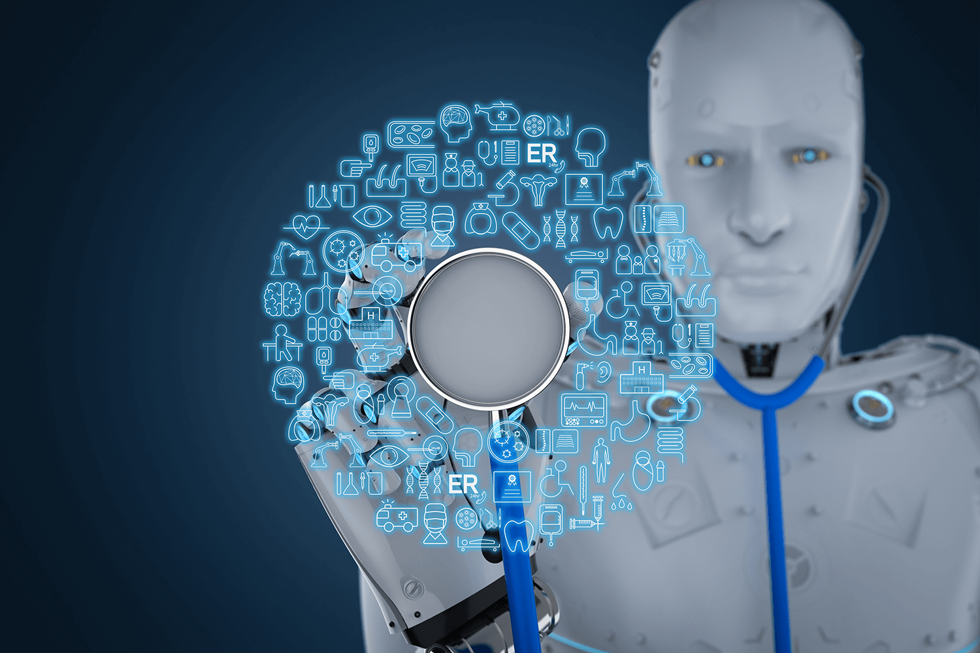
Prediction Model (Tools and Technologies):
Python, Pandas (Data manipulation and analysis), NumPy (Scientific computing), Matplotlib (Data visualization), Seaborn (Statistical data visualization) and Scikit-Learn (Machine learning, including SVM).

Slide 24
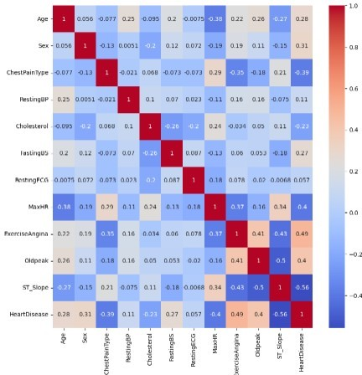
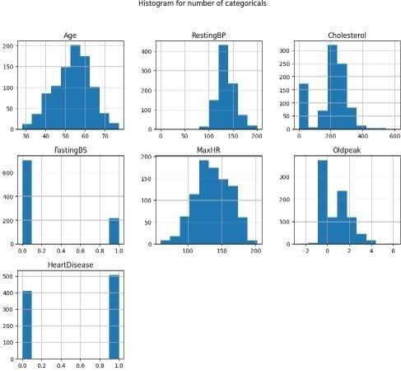

Confusion Matrix
Data Collection

Slide 25
Prediction Model.
Data Collection
Pre-process Data
Split Data
The dataset used in this study was sourced from a publicly available heart failure prediction dataset. The data consists of 918 entries with 12 columns, including both numerical and categorical variables related to patient health metrics and heart disease diagnosis.
Data cleaning involved inspecting the dataset for missing values, inconsistencies, and errors. Feature selection was conducted using correlation analysis to identify the most relevant features for predicting heart disease. Data transformation involved encoding categorical variables and scaling numerical features.
The dataset was split into training and test sets with an 80-20 split. The SVM model was trained on the training set.
Training Model
Evaluate Model
Deploy Model
SVM is a supervised machine learning algorithm that finds the hyperplane which best separates different classes in the feature space. It is particularly effective in high dimensional spaces and robust against overfitting, making it suitable for this heart disease prediction task.
Evaluating the model's performance is critical to understanding its effectiveness and reliability. The model's performance was evaluated using several metrics, including Accuracy, Precision, Recall, and F1-Score. These metrics provide a comprehensive view of the model's predictive capabilities.
The trained SVM model was saved for future use and deployment. The saved model was integrated into a Django web application to create an interactive platform for users.

Slide 26


Chatbot (AI Doctor).

Slide 27

AI Doctor (Tools and Technologies):
Python, Botpress and GPT.

Slide 28
Chatbot Features
15%
50%
50%
Standard 1: Greeting
Standard 2: Response Using AI Doctor
Standard 3: Response Using GPT
The chatbot initiates interactions with a friendly greeting, setting a welcoming tone for users.
Responses are generated using a custom-trained AI Doctor, based on a comprehensive healthcare knowledge base
For queries beyond the scope of the healthcare knowledge base, the chatbot leverages GPT models to provide insightful and relevant responses, ensuring comprehensive support for users.

Slide 29

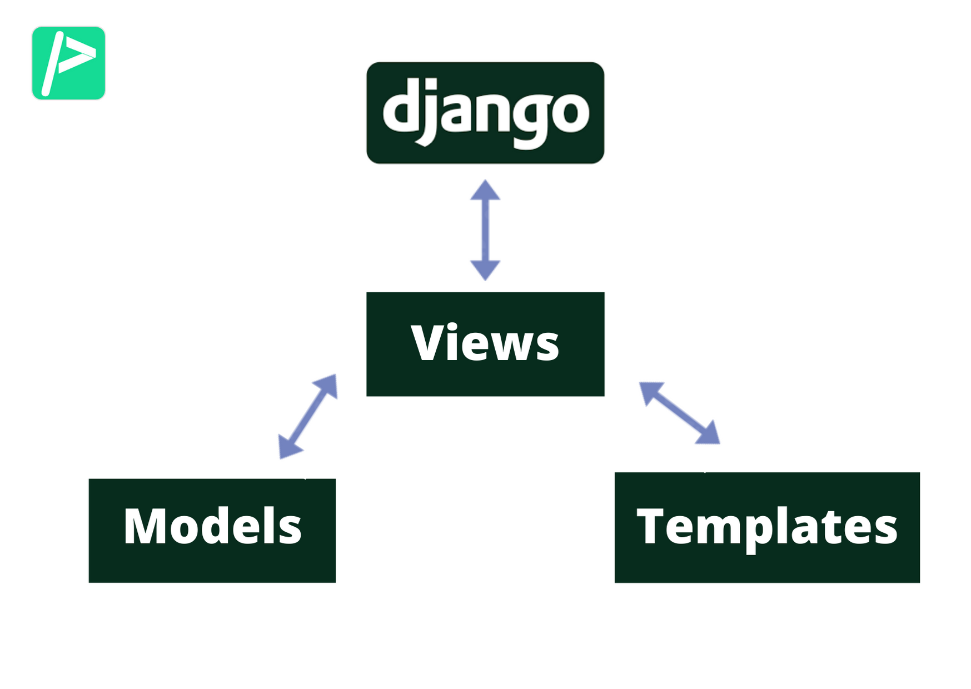
URLs and Views:
URLs: Connect user requests to appropriate view functions, enabling navigation throughout the web application.
Views: Process user input, implement business logic, and render responses or templates to users.

Slide 30
Key Features of URLs and Views:
URL Path | View Function | Description
/ | login_view | Serves the login page for user authentication. Validates credentials and redirects to the homepage.
/registration/ | registration_page | Handles new user registration. Validates input and saves user data securely.
/index/ | home | Displays the main homepage. Requires the user to be logged in.
/user_form/ | user_form | Collects user input for heart disease prediction. Uses the ML model to generate results and saves data to the database.
/logout/ | logout_view | Logs the user out and redirects to the login page for security.
/about_us/ | about_us | Provides information about the app and its purpose.
/doctor_ai/ | doctor_ai | Opens an AI-powered chatbot for medical assistance and advice.

Slide 31
Security and Authentication
Purpose:
Ensure only authorized users can access specific parts of the web application.
Protect sensitive user data, including login credentials and health-related information.
Objective:
To ensure a secure and seamless experience for users by safeguarding their data and preventing unauthorized access to application features.
Key Security Features:
Login Required
User Authentication
Secure Passwords

Slide 32
Key Functionality
Authentication: Secure login/logout with restricted access to authenticated pages like /index/.
Dynamic Responses: Views process user inputs, interact with the database, and serve predictions (e.g., heart disease results).
Reusable Forms: Views like registration_page and user_form leverage Django forms for clean input handling.
Navigation: URLs are intuitive and ensure smooth transitions between pages.

